Slide 1
Intrauterine Growth Restriction (IUGR) and Small for Gestational Age (SGA) Infants
Jessie Marks DNP, ARNP
Slides adapted from Yvonne Griffin

Slide 2
Learning objectives
Define small for gestational age, intrauterine growth restriction/fetal growth restriction and low birth weight.
List maternal, placental and fetal factors that may result in a newborn who is SGA or IUGR.
Differentiate between symmetric and asymmetric growth restriction.
Discuss assessment and management of the SGA and IUGR newborn.
Describe some possible long-term consequences of intrauterine growth retardation that may affect the health of the affected individual later in life.

Slide 3
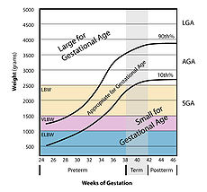
Small, Large and Appropriate for gestational Age
SGA, LGA and AGA
Best defined using customized birth weight percentiles based upon gestational age

Slide 4
Definitions: SGA
Small for gestational age (SGA)
Birth weight falls below the 10th percentile for gestational age or >2 SD below the mean
Maybe due to pathologic processes or normal variation
Up to 70% normal variation, constitutionally small

Slide 5
Definitions: IUGR
Intrauterine growth restriction (IUGR)
Fetus who has not grown at the expected in utero rate for weight, length or OFC
Symmetric (head % matches other fetal measurement percentiles (early insult, infection, chronic utero-placental insufficiency)
Asymmetric (head sparing – brain continues to grow but other measurements lag) – later onset utero-placental insufficiency

Slide 6
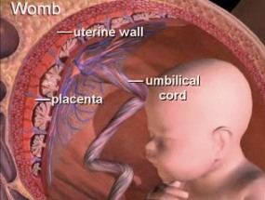
Pathophysiology of IUGR
Symmetric: Caused by such conditions as
Congenital infections
Chromosomal or other abnormalities
Maternal alcohol intake
Low socioeconomic status likely related to poor nutrition
Asymmetric: Caused by such conditions as
Placental insufficiency
Maternal hypertensive conditions
Long-standing maternal diabetes
Smoking
Living at altitude
Multiple gestation
ThePregnancyZone.com

Slide 7
Maternal Causes of IUGR/SGA
Maternal Causes
Smoking | Renal disease | Fibromyoma
Heart Disease | Drugs | Diabetes mellitus
Chronic HTN | Anemia | Short stature
Alcohol | Connective tissue Disorders, Lupus | Prior OB problems
Age (<16, >40) – probably related to other processes not age alone | Hemoglobinopathies | Malnutrition
Multiple gestation | Pre-eclampsia | Dysmorphologies

Slide 8
Placental Causes of IUGR/SGA
Placental Causes
Chorioamnionitis | Aberrant cord insertion
Placental cysts, tumors | Thrombosis, infarction
Placentitis, vasculitis, edema | Abruptio placentae
Hemangioma | Placenta previa
Single umbilical artery | Deciduitis

Slide 9
Uterine Causes of IUGR/SGA
Uterine Causes
Atheromatosis or arteriosclerosis of decidual spiral arteries
Decreased uteroplacental blood flow

Slide 10
Fetal Causes of IUGR/SGA
Fetal Causes
Chromosomal e.g. aneuploidy
Osteogenesis imperfecta
Malformations, e.g. anencephaly
Congenital infection, e.g. TORCH
Malaria
Parvovirus
HIV
Hemolytic Disease
Inborn Error of Metabolism

Slide 11
Major Contributing Factors
In developed countries
Smoking: 3-4.5X more likely to result in IUGR infant
Placental insufficiency
In developing countries
Infections, especially malaria
Poor nutrition

Slide 12
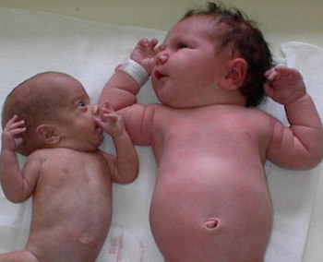
Assessment of IUGR/SGA
Pregnancy history
Placental examination
Physical exam
Laboratory assessment

Slide 13
Initial Management for IUGR/SGA
Accurate measurement of length, weight, and head circumference.
Accurate assessment of gestational age.
Thermoregulation (radiant warmer, isolette)
Glucose surveillance – first level obtained within 1-2 hours of birth
Calcium monitoring- starting at 12 hours of life, for low levels provide adequate calcium
Monitor for polycythemia - CBC
Early feeding or parenteral therapy

Slide 14
Further Evaluation and Management
Review history for risk factors
Assess for signs of congenital infection- blood serology tests or urine studies if indicated
Assess for physical anomalies- genetic consult or chromosomal studies if indicated
Evaluate for prenatal drug or toxin exposure
Pathological examination of placenta
Support adequate nutritional intake
Notes:
If cause is from infection –treat if appropriate
Refer for genetic consult if appropriate

Slide 15
Outcome of IUGR Infants
IUGR associated with
Increased morbidity and mortality
Short stature
Cardiovascular disease
Insulin resistance
Diabetes mellitus Type 2
Dyslipidemia
End-stage renal disease
Decreased intelligence and cognition, mostly subtle
Problems associated with structural alterations in the brain, including decreased brain weight, cells, and myelin

Slide 16
Catch-Up Growth
Monitor weight and growth closely
Most infants catch-up but 10% do not.
Those with greatest catch-up growth at highest risk for insulin resistance, diabetes, obesity, and heart disease as adults.

Slide 17
References
Argente, J. Mehis, O., Barrios, V. (2010). Growth and body composition in very young SGA children. Pediatr Nephrol, 25(4),679-85.
Lawrence, E. J. (2006). Part 1: A matter of size: Evaluating the growth-restricted neonate. Advances in Neonatal Care, 6(6),313-322.
McCowan, L., Horgan, R. P. (2009). Risk factors for small for gestational age infants. Best Pract Res Clin Obstet Gynaecol, 23(6),779-93.
Halliday, H. L. (2009). Neonatal management and long-term sequelae. Best Pract Res Clin Obstet Gynaecol, 23(6),871-80.
Thureen, P. J., Anderson, M. S., Hay, W. W. (2001). The small-for-gestational age infant. NeoReviews, 2, 139-149.
Zhang, J. Merialdi, M., Platt, L. D., Kramer, M. S. (2010). Defining normal and abnormal fetal growth: Promises and challenges. Am J Obstet Gynecol, 202(6),522-8.

